Slide 1
Epigenetics Genetics/th. Class
fourteen&Lectures thirteen
Dr. Ibtesam B. Hassan

Slide 2
What is Epigenetics?
Epigenetics is the study of inherited changes in phenotype (appearance) or gene expression caused by mechanisms other than changes in the underlying DNA sequence.
These changes may remain through cell divisions for the remainder of the cell's life and may also last for multiple generations.
Changes in gene expression that do not involve alterations in DNA base sequence

Slide 3
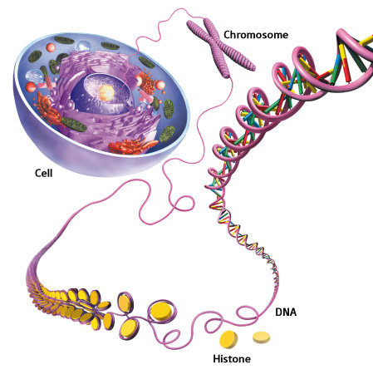

Slide 4
Genetics vs. Epigenetics

Slide 5
Epigenetic Modifications
DNA Methylation
Histone Modification (e.g. Acetylation, methylation)
Non-coding RNAs (e.g. microRNA)
All Regulate Gene Expression

Slide 6
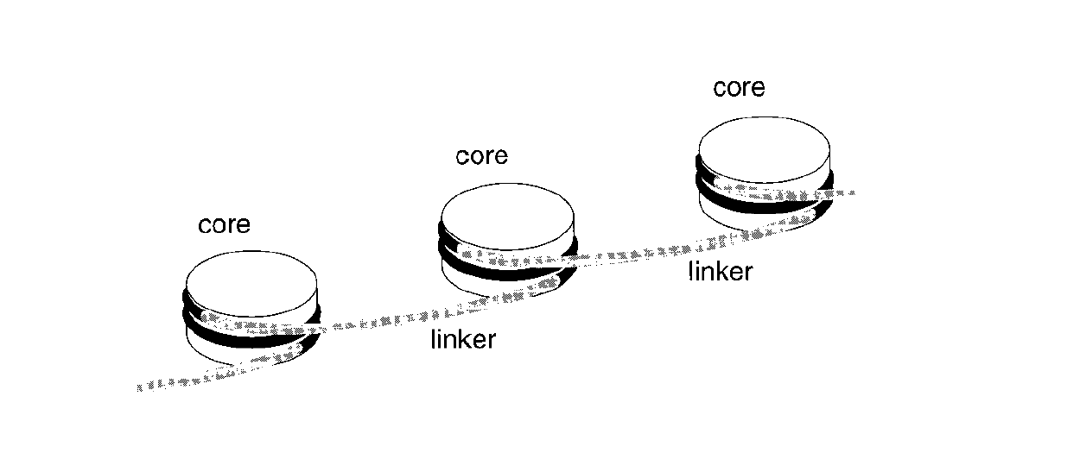
Twenty-Five Years of the Nucleosome,
Fundamental Particle of the Eukaryote Chromosome
Roger D. Kornberg and Yahli Lorch; Cell, 1999.

Slide 7
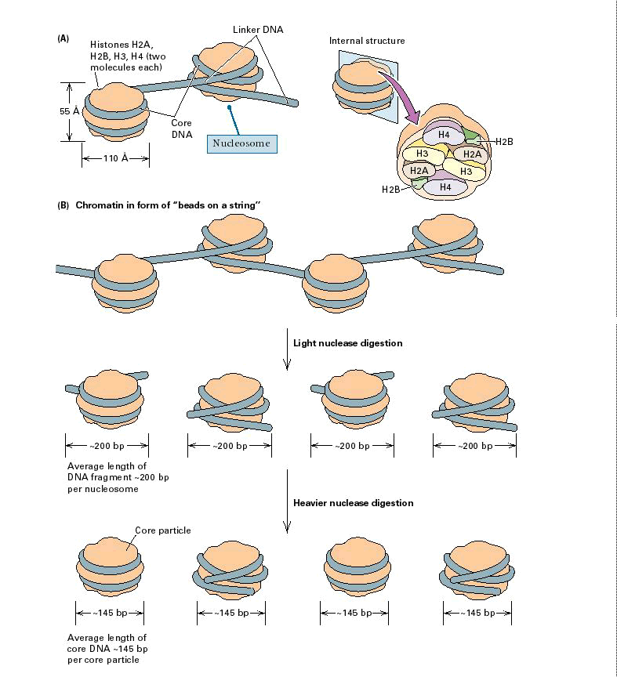
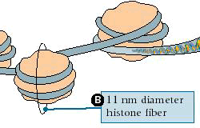
Nucleosome:
147 bp of DNA
Histone octamer
= 1.7 turns

Slide 8
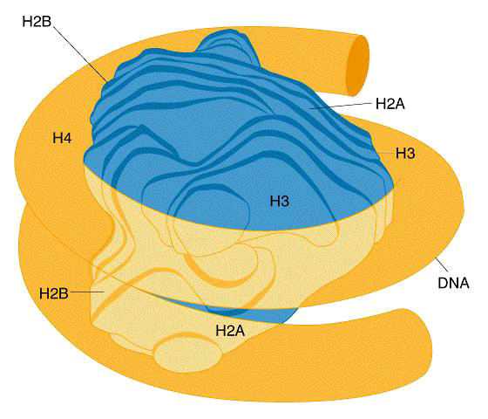
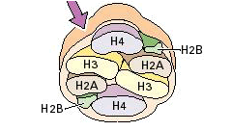
The nucleosome: histones plus DNA

Slide 9
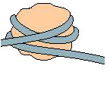
Chromatin: nucleosomal arrays
Nucleosome: DNA plus histone octamer
DNA wound around the histone octamer:
core DNA
DNA between nucleosomes: linker DNA

Slide 10
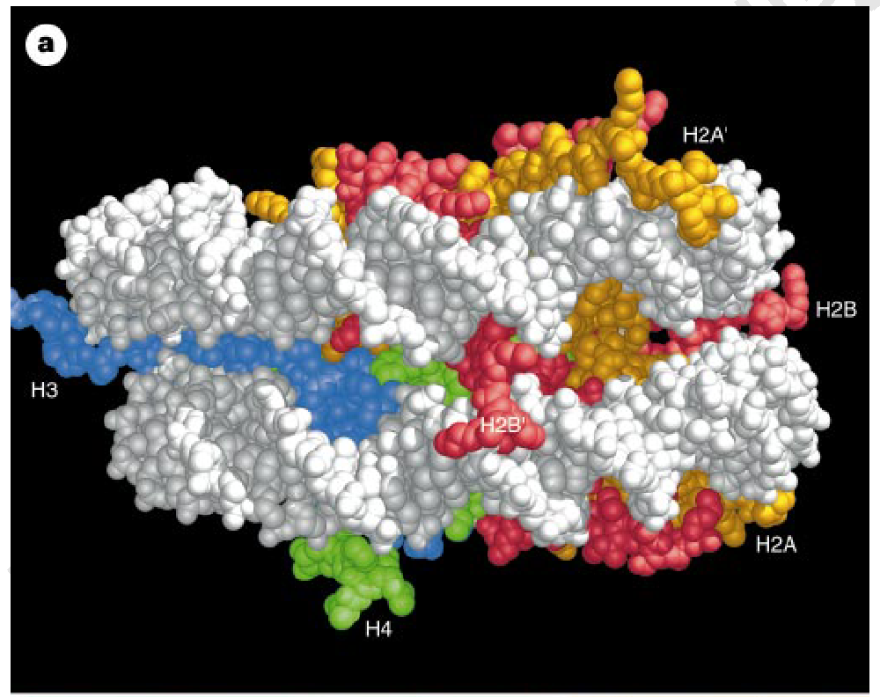

Slide 11
Two classes of histones (canonical)
Core Histones
H2A conserved
H2B conserved
H3 highly conserved
H4 very highly conserved
Linker Histones
H1 not conserved
Small proteins, ca. 10 kD, very basic
Three domains
A. Histone fold
B. Histone fold extension
C. Extended N (and C)-termini

Slide 12
Euchromatin
Transcriptionally active, less compacted
Heterochromatin
Less transcriptionally active, very compacted
a) constitutive heterochromatin
centromeres, telomeres
b) facultative heterochromatin
rDNA, transposons, inactive X chromosome

Slide 13
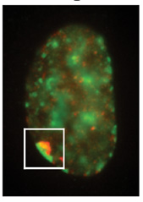
Barr Body Region
* Immunofluorescent straining of the human interphase nucleus.
* The white box indicates the Barr body region where the inactive X chromosome
resides during interphase.
Chadwick and Willard (2004) PNAS

Slide 14
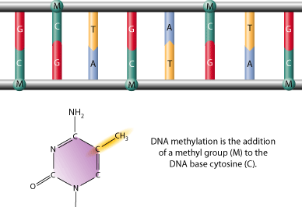
DNA methylation is the addition of a methyl group to the carbon-5 position of cytosine residues.

Slide 15
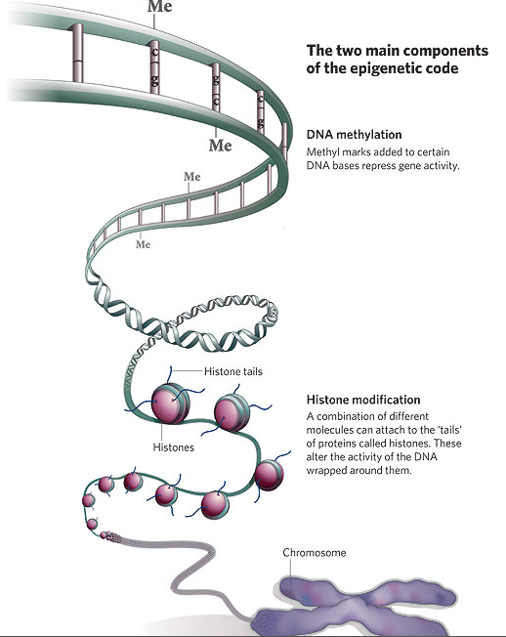
DNA methylation status
is important

Slide 16
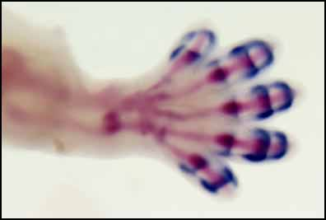
aims to identify, catalogue and interpret genome-wide DNA methylation patterns of all human genes in all major tissues.
Methylation is tissue specific and is of major importance in the regulation of gene expression during development.

Slide 17
All levels of chromatin condensation have been
implicated in controlling accessibility of
the genomic DNA
effect on:
replication, recombination, repair, and transcription

Slide 18
Mechanism exist to “condense” chromatin
Histone modifying enzymes
alter histone tail modifications
DNA methylases,
Recruitment of chromatin binding proteins
Polycomb proteins
Heterochromatin Protein
Can alter gene activity without change in DNA

Slide 19
Epigenetic/chromatin phenomena
Chromatin-based restriction of genome accessibility during
differentiation
Selective activation of genome after perception of stimulus
(influence of environment/stress)
Mitotic maintenance of cell identity (or loss there of in cancer)
Dosage compensation in the male versus female genome
(X inactivation in mammals)
Memory, Behavior, Aging

Slide 20
cancer
The human body is prone to developing cancer, from a very early stage of life, until the end of life.
The human genome has several built in tumour suppressor genes, whose protein products suppress the formation of tumours. It is important for these genes to continue expressing their tumour suppressor proteins as long as the person lives.
One way these genes can lose their ability to make protective proteins is through methylation.

Slide 21
Epigenetics and The Environment
Epigenetic changes can be inherited mitotically in somatic cells
Pre-natal and early post-natal exposures can result in changes in risk of developing disease
Nutrition
Xenobiotic chemicals
Behavioural Factors
Reproductive Factors, Hormonal Exposures Epigenetic alterations may also be inherited transgenerationally (developmental origins of adult-onset disease)

